Slide 1
RSS Reader & RecyclerView

Slide 2
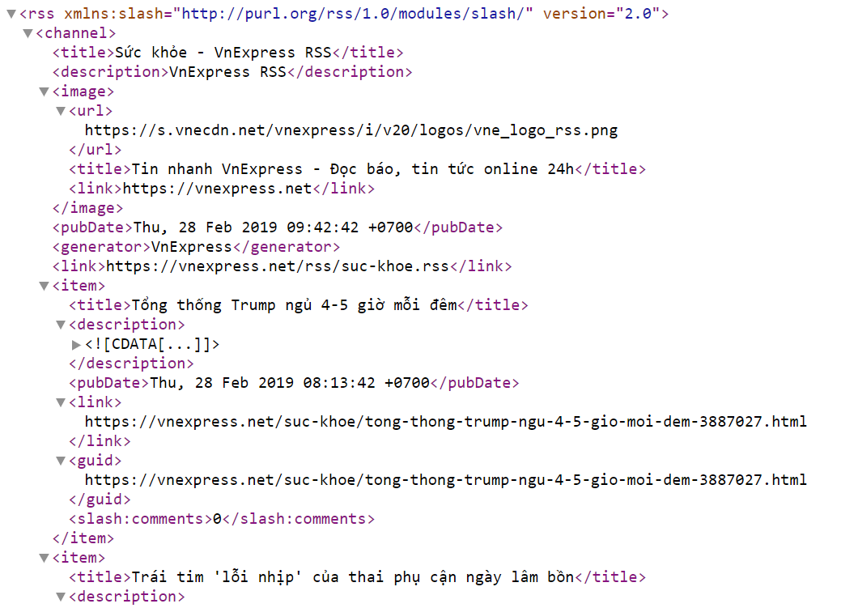
Xml Parser – RSS Reader
An RSS feed is a plain text document, formatted in XML. Being XML, it is relatively easy for humans to read, and also not difficult for programs to parse

Slide 3
Xml Parser – RSS Reader
Create a new Android Studio project with an empty activity, which we’ve named RSSReader
In the AndroidManifiest.xml file, we include the INTERNET permission. Since the rss reader will fetch feeds from the internet, we must declare this permission
Also, we intend to use the support library, RecyclerView and design support library, so we add those to our build.gradle (app) file
<uses-permission android:name="android.permission.INTERNET" />
implementation 'com.android.support:appcompat-v7:28.0.0‘
implementation 'com.android.support:recyclerview-v7:28.0.0' implementation 'com.android.support:design:28.0.0'

Slide 4
Xml Parser – RSS Reader
RecyclerView is a modern, properly planned and more efficient improvement on the ListView.
The ListView (and RecyclerView) are android widgets that can hold (and display) a collection of items. Each item in the list is displayed in an identical manner, and this is achieved by defining a single layout file that is inflated for each list item.
Since the total number of items in a list can be arbitrarily large, it would be impractical to inflate the layout for each list item immediately the ListView is created. The ListView was created in such a way that Views that are no longer needed (possibly when the user has scrolled away) can be reused to display other items in the list as necessary.
To recap, the RecyclerView has an Adapter (to manage the items in the list), a ViewHolder (to hold a view representing a single list item), a LayoutManager (to handle the layout and scroll direction of the list) and an ItemAnimator (to handle animations).

Slide 5
Xml Parser – RSS Reader
Some of the issues experienced with ListView, which RecyclerView is designed to solve include:
ListView handled layout management. This might seem intuitively correct, however it is more work for the ListView, compared to the RecyclerView, which requires a LayoutManager.
Only vertical scrolling is allowed in ListView. Items in a ListView can be arranged, displayed and scrolled in a vertical list only, whereas RecyclerView’s LayoutManager can create both vertical and horizontal lists (and diagonal lists if you care to implement that).
The ViewHolder pattern is not enforced by ListView. The ViewHolder pattern holds Views in a cache, when created, and reuses Views from this cache as needed. While the ListView encouragesthe use of this pattern, it did not require it, and so, developers could ignore the ViewHolder pattern and create a new View every time. RecyclerView forces usage of this pattern.
ListView has no animations. Animating removal and/or insertion of new items is not designed into ListView. However, with the increased maturity of the android platform and the material design obsession with aesthetics and animations, RecyclerView, by default, animates adding and removing list items. (Actually, RecyclerView.ItemAnimator handles these animations.)

Slide 6
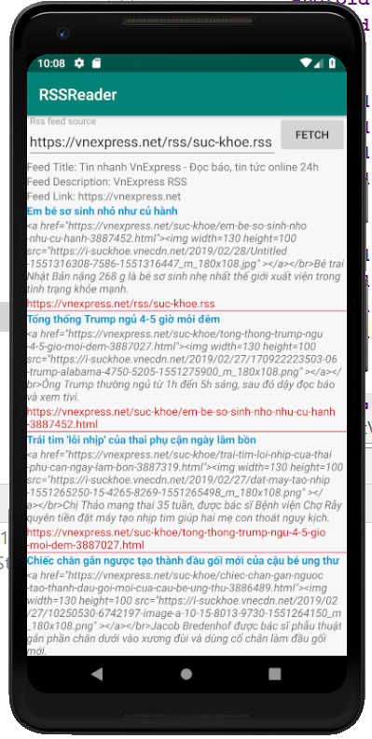
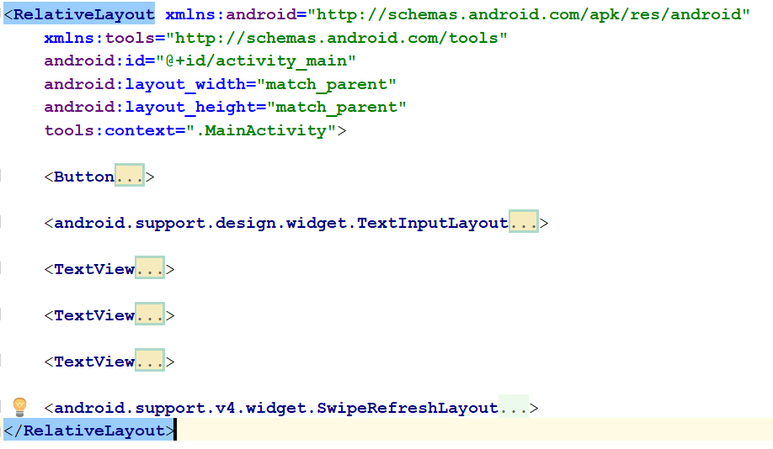
Xml Parser – RSS Reader - MainLayout

Slide 7
Xml Parser – RSS Reader - MainLayout
<Button android:id="@+id/fetchFeedButton" android:layout_width="wrap_content" android:layout_height="wrap_content" android:layout_alignParentEnd="true" android:text="Fetch" /> <android.support.design.widget.TextInputLayout android:id="@+id/textInputLayout" android:layout_width="match_parent" android:layout_height="wrap_content" android:layout_toStartOf="@id/fetchFeedButton" android:hint="Rss feed source"> <EditText android:id="@+id/rssFeedEditText" android:layout_width="match_parent" android:layout_height="wrap_content" /> </android.support.design.widget.TextInputLayout>
<TextView android:id="@+id/feedTitle" android:layout_width="match_parent" android:layout_height="wrap_content" android:layout_below="@id/textInputLayout" android:text="Feed Title: " /> <TextView android:id="@+id/feedDescription" android:layout_width="match_parent" android:layout_height="wrap_content" android:layout_below="@id/feedTitle" android:text="Feed Description: " /> <TextView android:id="@+id/feedLink" android:layout_width="match_parent" android:layout_height="wrap_content" android:layout_below="@id/feedDescription" android:text="Feed Link: " />

Slide 8
Xml Parser – RSS Reader - MainLayout
A SwipeRefreshLayout is a design support library widget that allows users pull down to refresh, and shows a nice circular progress bar.
<android.support.v4.widget.SwipeRefreshLayout android:id="@+id/swipeRefreshLayout" android:layout_width="match_parent" android:layout_height="match_parent" android:layout_below="@id/feedLink"> <android.support.v7.widget.RecyclerView android:id="@+id/recyclerView" android:layout_width="match_parent" android:layout_height="match_parent" /> </android.support.v4.widget.SwipeRefreshLayout>

Slide 9
Xml Parser – RSS Reader - RssFeedModel
RssFeedModel is a simple helper class we created to hold title, description and link information for an RSS feed item.
public class RssFeedModel { public String title; public String link; public String description; public RssFeedModel(String title, String link, String description) { this.title = title; this.link = link; this.description = description; } }

Slide 10
Xml Parser – RSS Reader – Item’s layout
To display each feed item, we create a layout file, called item_rss_feed.xml
<LinearLayout xmlns:android="http://schemas.android.com/apk/res/android" android:layout_width="match_parent" android:layout_height="wrap_content" android:orientation="vertical"> <TextView android:id="@+id/titleText" android:layout_width="match_parent" android:layout_height="wrap_content" android:textStyle="bold" android:textColor="@android:color/holo_blue_dark"/> <TextView android:id="@+id/descriptionText" android:layout_width="match_parent" android:layout_height="wrap_content" android:textStyle="italic"/>

Slide 11
Xml Parser – RSS Reader – Item’s layout
To display each feed item, we create a layout file, called item_rss_feed.xml (continue…)
<TextView android:id="@+id/linkText" android:layout_width="match_parent" android:layout_height="wrap_content" android:textColor="@android:color/holo_red_dark"/> <View android:layout_width="match_parent" android:layout_height="1dp" android:background="@color/colorAccent" /> </LinearLayout>

Slide 12
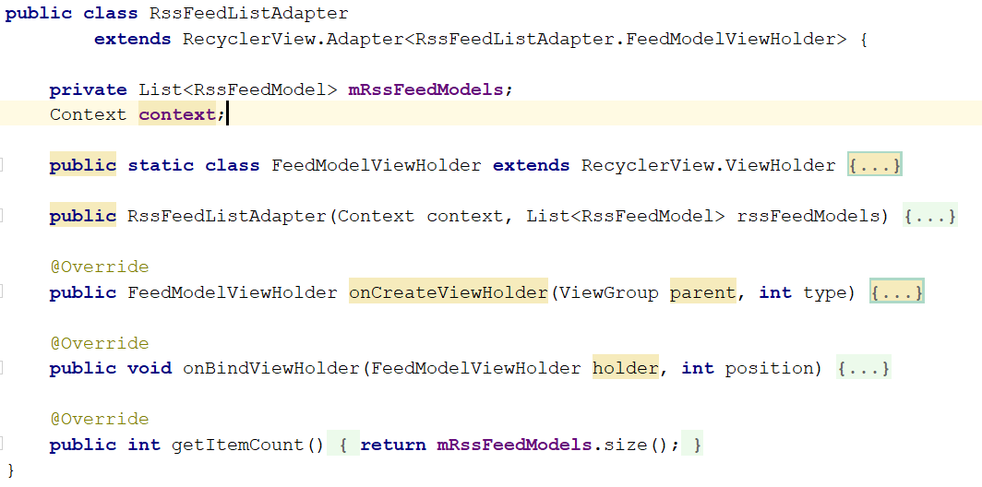
Xml Parser – RSS Reader – RssFeedListAdapter

Slide 13
Xml Parser – RSS Reader – RssFeedListAdapter
public static class FeedModelViewHolder extends RecyclerView.ViewHolder { private View rssFeedView; public FeedModelViewHolder(View v) { super(v); rssFeedView = v; } } public RssFeedListAdapter(Context context, List<RssFeedModel> rssFeedModels) { mRssFeedModels = rssFeedModels; this.context = context; } @Override public FeedModelViewHolder onCreateViewHolder(ViewGroup parent, int type) { View v = LayoutInflater.from(parent.getContext()) .inflate(R.layout.item_rss_feed, parent, false); FeedModelViewHolder holder = new FeedModelViewHolder(v); return holder; }

Slide 14
Xml Parser – RSS Reader – RssFeedListAdapter
@Override public void onBindViewHolder(FeedModelViewHolder holder, int position) { final RssFeedModel rssFeedModel = mRssFeedModels.get(position); ((TextView)holder.rssFeedView.findViewById(R.id.titleText)).setText(rssFeedModel.title); ((TextView)holder.rssFeedView.findViewById(R.id.descriptionText)) .setText(rssFeedModel.description); ((TextView)holder.rssFeedView.findViewById(R.id.linkText)).setText(rssFeedModel.link); ((TextView)holder.rssFeedView.findViewById(R.id.linkText)).setOnClickListener(new View.OnClickListener() { @Override public void onClick(View v) { String lnk = ((TextView)v).getText().toString(); Uri uri = Uri.parse(lnk); Intent i = new Intent(Intent.ACTION_VIEW, uri); if (i.resolveActivity(context.getPackageManager())!=null) { try { i.setFlags(Intent.FLAG_ACTIVITY_NEW_TASK); context.startActivity(i); } catch (Exception e) { Log.i("Err", e.getMessage().toString()); } } } }); }

Slide 15
Xml Parser – RSS Reader – MainActivity
private RecyclerView mRecyclerView; private EditText mEditText; private Button mFetchFeedButton; private SwipeRefreshLayout mSwipeLayout; private TextView mFeedTitleTextView; private TextView mFeedLinkTextView; private TextView mFeedDescriptionTextView; private List<RssFeedModel> mFeedModelList; private String mFeedTitle; private String mFeedLink; private String mFeedDescription;

Slide 16
Xml Parser – RSS Reader – MainActivity
@Override protected void onCreate(Bundle savedInstanceState) { super.onCreate(savedInstanceState); setContentView(R.layout.activity_main); mRecyclerView = (RecyclerView) findViewById(R.id.recyclerView); mEditText = (EditText) findViewById(R.id.rssFeedEditText); mFetchFeedButton = (Button) findViewById(R.id.fetchFeedButton); mSwipeLayout = (SwipeRefreshLayout) findViewById(R.id.swipeRefreshLayout); mFeedTitleTextView = (TextView) findViewById(R.id.feedTitle); mFeedDescriptionTextView = (TextView) findViewById(R.id.feedDescription); mFeedLinkTextView = (TextView) findViewById(R.id.feedLink); mRecyclerView.setLayoutManager(new LinearLayoutManager(this)); mFetchFeedButton.setOnClickListener(new View.OnClickListener() { @Override public void onClick(View view) { new FetchFeedTask().execute((Void) null); } }); mSwipeLayout.setOnRefreshListener(new SwipeRefreshLayout.OnRefreshListener() { @Override public void onRefresh() { new FetchFeedTask().execute((Void) null); } }); mEditText.setText("https://vnexpress.net/rss/suc-khoe.rss"); }

Slide 17
Xml Parser – RSS Reader – MainActivity
Both the Button and SwipeRefreshLayout perform the same action, which is to start a new FetchFeedTask
The FetchFeedTask is an AsyncTask, which allows us perform possible long running tasks in a background thread
If you try to fetch feeds from a url on the main thread, your app will become unresponsive, and can appear to the user to have stopped working
Ever since Ice-cream Sandwich, Android no longer allows apps make network calls on the main thread

Slide 18
Xml Parser – RSS Reader – MainActivity
The FetchFeedTask has three simple methods:
onPreExecute, which is called before the long running task starts, and is executed on the calling thread.
doInBackground, which is the long running task, and is executed in a new thread
onPostExecute, which is called after the long running task is complete, and is executed on the calling thread.
Since Android allows manipulation of UI elements (Buttons, SwipeRefreshLayout, etc) only on the UI/Main thread, we can update the UI both in onPreExecute, and onPostExecute, but not in doInBackground.

Slide 19
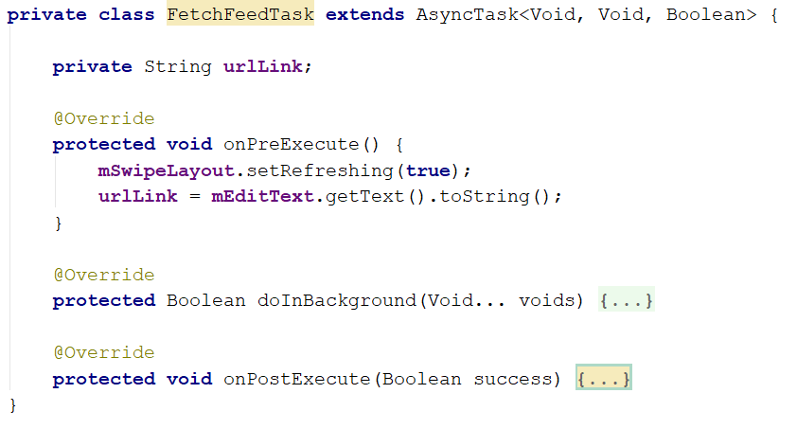
Xml Parser – RSS Reader – MainActivity - FetchFeedTask

Slide 20
Xml Parser – RSS Reader – MainActivity - FetchFeedTask
@Override protected Boolean doInBackground(Void... voids) { if (TextUtils.isEmpty(urlLink)) return false; try { if(!urlLink.startsWith("http://") && !urlLink.startsWith("https://")) urlLink = "http://" + urlLink; URL url = new URL(urlLink); InputStream inputStream = url.openConnection().getInputStream(); mFeedModelList = parseFeed(inputStream); return true; } catch (IOException e) { //Log.e(TAG, "Error", e); Toast.makeText(getApplicationContext(), e.toString(), Toast.LENGTH_SHORT).show(); } catch (XmlPullParserException e) { //Log.e(TAG, "Error", e); Toast.makeText(getApplicationContext(), e.toString(), Toast.LENGTH_SHORT).show(); } return false; }

Slide 21
Xml Parser – RSS Reader – MainActivity - FetchFeedTask
@Override protected void onPostExecute(Boolean success) { mSwipeLayout.setRefreshing(false); if (success) { mFeedTitleTextView.setText("Feed Title: " + mFeedTitle); mFeedDescriptionTextView.setText("Feed Description: " + mFeedDescription); mFeedLinkTextView.setText("Feed Link: " + mFeedLink); // Fill RecyclerView mRecyclerView.setAdapter(new RssFeedListAdapter(getApplicationContext(), mFeedModelList)); } else { Toast.makeText(MainActivity.this, "Enter a valid Rss feed url", Toast.LENGTH_LONG).show(); } }

Slide 22
Xml Parser – RSS Reader – MainActivity – parseFeed
public List<RssFeedModel> parseFeed(InputStream inputStream) throws XmlPullParserException, IOException { String title = null; String link = null; String description = null; boolean isItem = false; List<RssFeedModel> items = new ArrayList<>(); try { XmlPullParser xmlPullParser = Xml.newPullParser(); xmlPullParser.setFeature(XmlPullParser.FEATURE_PROCESS_NAMESPACES, false); xmlPullParser.setInput(inputStream, null); //xmlPullParser.nextTag(); while (xmlPullParser.next() != XmlPullParser.END_DOCUMENT) { int eventType = xmlPullParser.getEventType(); String name = xmlPullParser.getName(); if(name == null) continue;

Slide 23
Xml Parser – RSS Reader – MainActivity – parseFeed
if(eventType == XmlPullParser.END_TAG) { if(name.equalsIgnoreCase("item")) { isItem = false; } continue; } if (eventType == XmlPullParser.START_TAG) { if(name.equalsIgnoreCase("item")) { isItem = true; continue; } } Log.d("MyXmlParser", "Parsing name ==> " + name); String result = ""; if (xmlPullParser.next() == XmlPullParser.TEXT) { result = xmlPullParser.getText(); xmlPullParser.nextTag(); } if (name.equalsIgnoreCase("title")) { title = result; } else if (name.equalsIgnoreCase("link")) { link = result; } else if (name.equalsIgnoreCase("description")) { description = result; }
if (title != null && link != null && description != null) { if(isItem) { RssFeedModel item = new RssFeedModel (title, link, description); items.add(item); } else { mFeedTitle = title; mFeedLink = link; mFeedDescription = description; } title = null; link = null; description = null; isItem = false; } } return items; } finally { inputStream.close(); } }

